Slide 1
FPGA Neural Network
Alex Karantza & Sam Skalicky

Slide 2
What are Neural Networks?
The history of computer science is filled with attempts to mimic biological systems
Neural networks are a kind of optimization function, modeled after a functional understanding of the cells that make up the animal nervous system

Slide 3
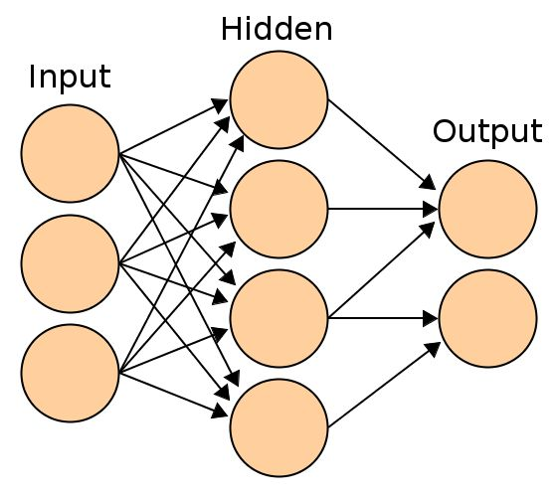
What are Neural Networks?
Artificial Neural Networks are directed graphs
The nodes are Neurons, and the connections are Weights
In a feed-forward network, inputs are entered at one end and results are produced at the other
This kind of three-layer network is very common

Slide 4
What are Neural Networks?
Neural Networks can learn
By adjusting the connection weights, the output neurons can describe any function
Even functions specified only incompletely, or by example
Training a network is the same as minimizing the function with respect to the weights

Slide 5
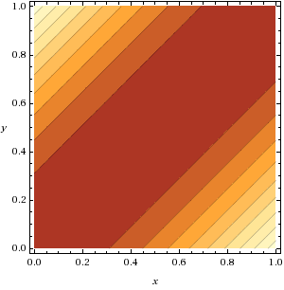
How a Network Understands ⊕
F(x, y) ≃ x ⊕ y
A composition of nonlinear functions
With enough neurons, any dimensionality and complexity can be learned

Slide 6
Goals for this project
Learn about FPGAs
Implement accurate algorithms
IEEE Floating Point
Implement a Fast Neural Network
4 bit text recognition
Scalable Network

Slide 7
FPGA Implementation
We implemented a network capable of learning any two-input function, such as AND, OR, XOR, etc
This is the smallest network that is useful
It could be expanded to any size, simply by increasing the number of nodes

Slide 8
Structural Overview
Neuron: sums up signals
Connection: passes along weighted signals
Sigmoid: clamps large unsigned values
Network: sets up topology, uses above
Interface/Testbench

Slide 9
Dealing with Numbers
FPGA has no floating point support
Use fixed point signed & unsigned numbers, converting where necessary
Sigmoid requires a lot of dynamic range
Taylor series is best, we settled for a piecewise linear approximation

Slide 10
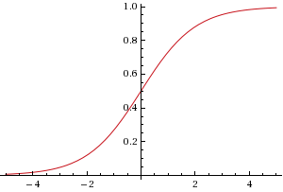
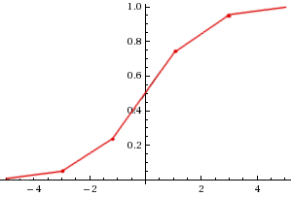
The Sigmoid Function
Continuous
Piecewise

Slide 11
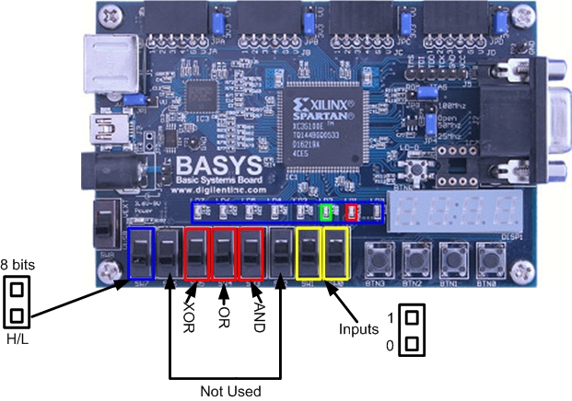
User Interaction
Inputs
Output type
Function
Input values
Output
8 LEDs

Slide 12
Live Demo

Slide 13
Device Utilization & Performance
Total resources used: 19% | Device Utilization Summary
Logic Utilization | Used | Available | Utilization
Number of Slice Latches | 22 | 1,920 | 1%
Occupied Slices | 197 | 960 | 20%
4 input LUTs | 360 | 1,920 | 18%
 | Logic | 328 | 17%
 | Route-thru | 32 | 3%
Number of bonded IOBs | 10 | 108 | 9%
MULT18X18SIOs | 4 | 4 | 100%
Table 1: Device Utilization table for Spartan 3E-100
Node | Levels | Time
Data In | 29 | 13ns
Data Out | 2 | 5ns
Table 2: Data Speed

Slide 14
Conclusion
Demonstrated the feasibility of applying a theoretical understanding of neural networks to the design of a parallel asynchronous digital system
The prototype was limited by the computational resources available, but could be expanded with little effort
Biologically-inspired algorithms can be useful to solve difficult problems, and hardware can implement them effectively

Slide 16
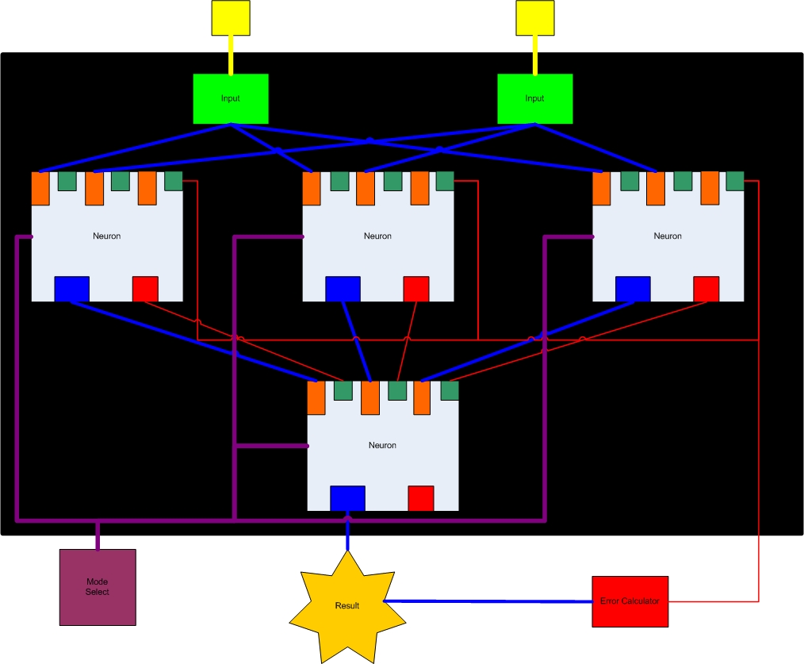
Diagram

Slide 17
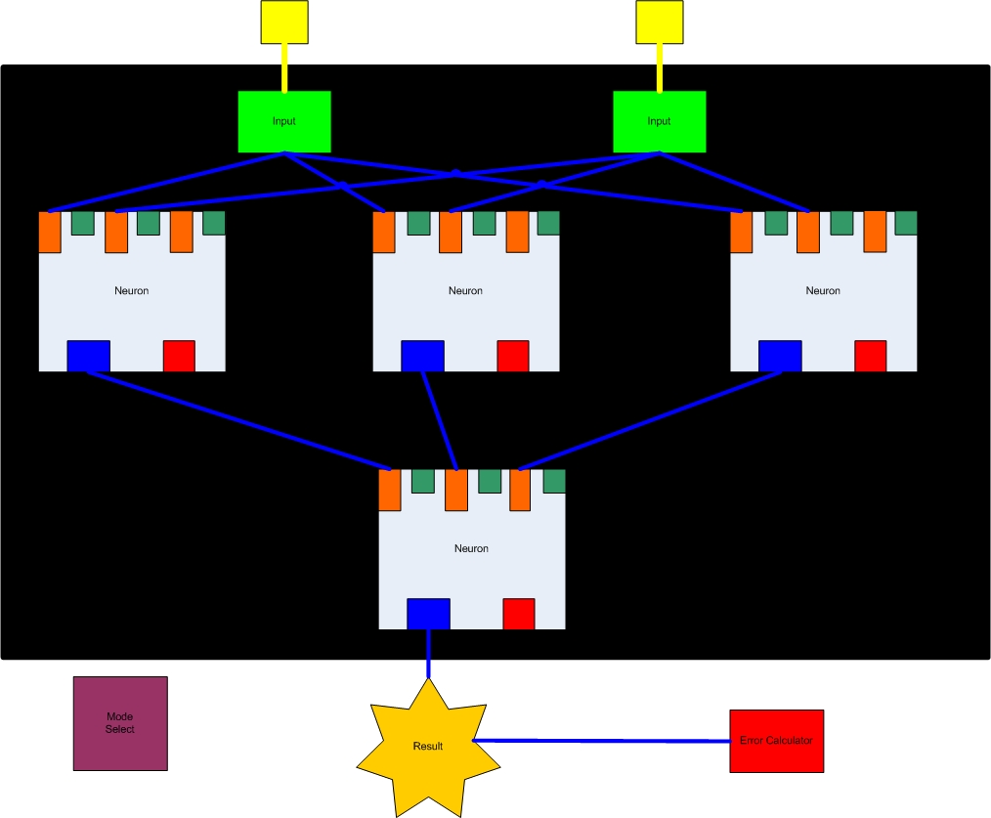
Diagram

Slide 18
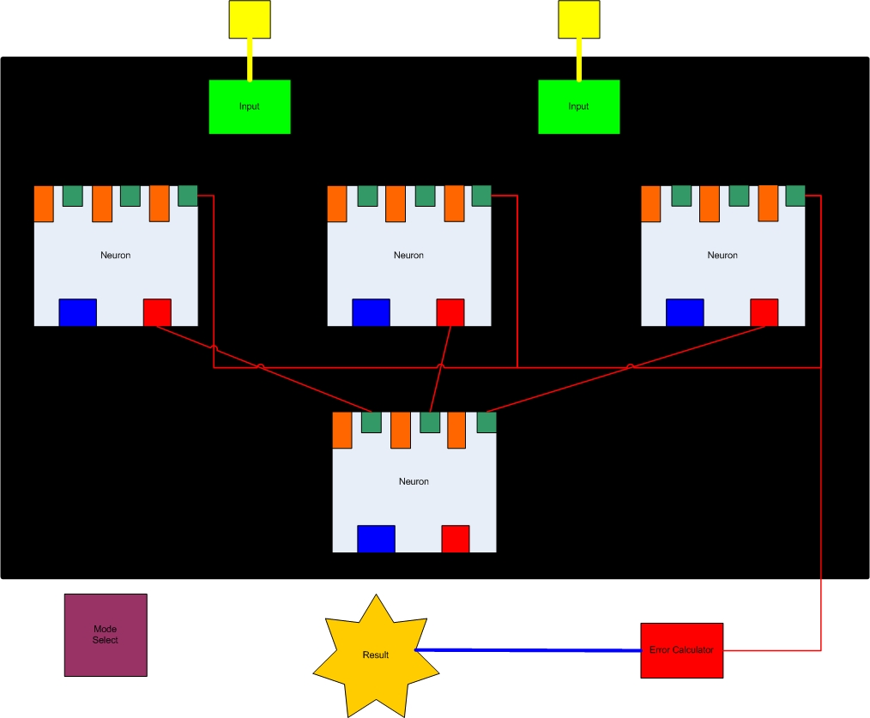
Diagram

Slide 19
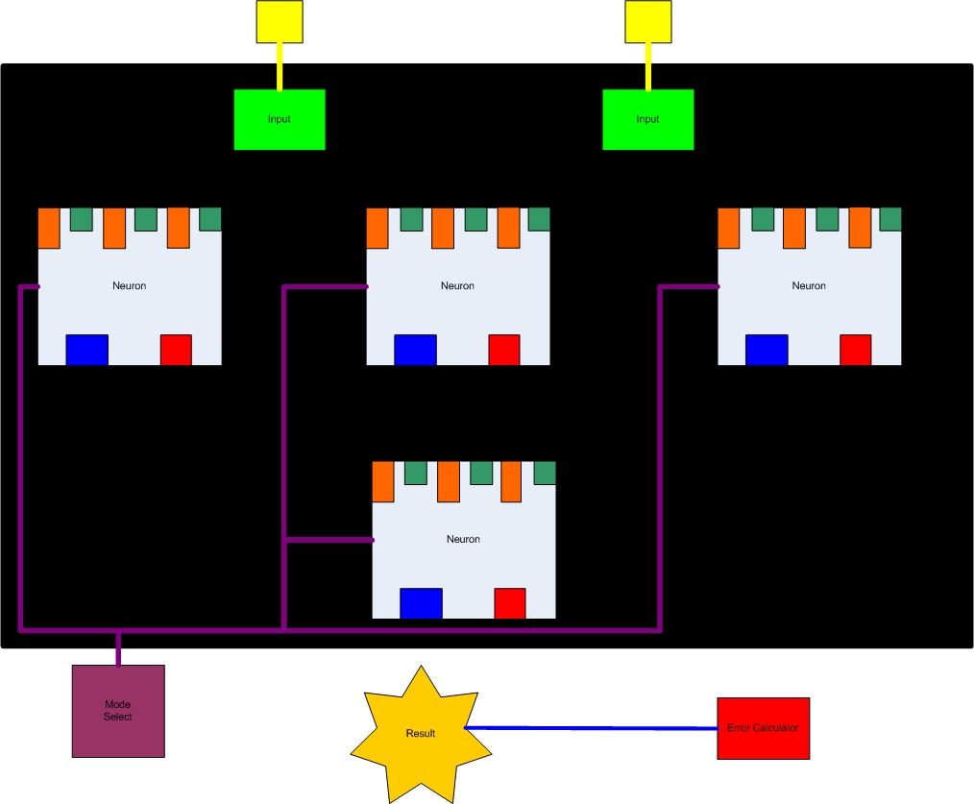
Diagram

